Slide 1
Traumatic Brain Injury (TBI)
Team 10
Spreading awareness of TBI

Slide 2
Table of contents
01
02
03
04
05
Introduction
Symptoms
Risks about TBI
Background of the TBI
Symptoms of TBI
Relevant data to show more details about TBI
TBI in Military
Effective care
Details about TBI in Military
Effective care to handle TBI cases

Slide 3
01
Introduction
Background of TBI

Slide 4
Traumatic Brain Injury
Brain Injury Awareness Month, observed each March, was established 3 decades ago to educate the public about the incidence of brain injury and the needs of persons with brain injuries and their families.
Traumatic Brain Injury (TBI) is caused by a bump, blow, or jolt to the head, or penetrating head injury which can lead to short- or long-term changes affecting thinking, sensation, language, or emotion.
The goal of this project is to spread awareness for just how common TBIs are - both in civilian and military populations.

Slide 5
What are TBI Symptoms?
Headaches
Memory problems
Difficulty concentrating
Seizures
Mood swings
Sensitivity to light or sound
Motor impairment

Slide 6
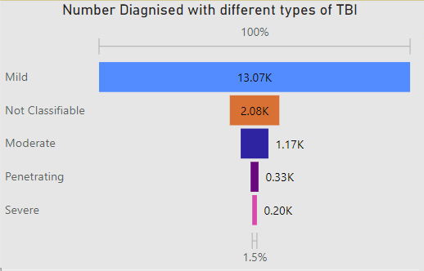
What are the severity levels of TBI?
There are different Levels of severity based off of loss of consciousness, length of memory loss and responsiveness after the injury.
Mild injuries—commonly called concussions—are those that usually result in no persistent symptoms.
Moderate and Penetrative have cognitive or behavioral risks
Most severe injuries can result in patients remaining in a coma or vegetative state

Slide 7
Causes of Traumatic Brain Injury
Unintentional falls are the leading cause of Traumatic Brain Injury
Injury Mechanism | Total number
Unintentionally struck by or against an object | 980
Assault | 9690
Unintentional Falls | 96568
Motor Vehicle Crashes | 931
Other unintentional injury, mechanism unspecified | 859

Slide 8
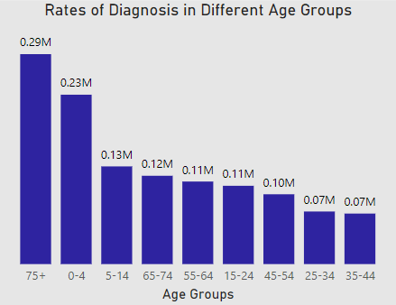
Which Age Groups are at Risk?
Adults 75 years and older and Children aged 0 - 4 years are most likely to sustain a TBI
People aged 35 - 44 have lower rates of diagnosis of TBI as compared to other age groups

Slide 9
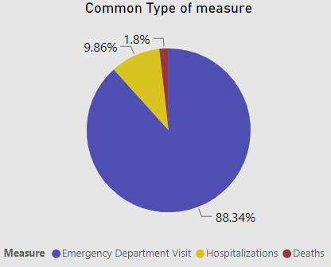
What Measures are taken?
88.34% people with TBI are most likely to be treated in an emergency department
9.8% of people sustain a TBI severe enough to require hospitalization
1.8% Deaths caused by TBI

Slide 10
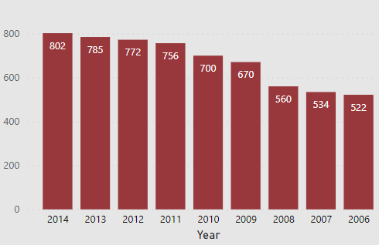
Diagnosis Rates in Different Years
Diagnosis Rates of TBI has increased from 2006 to 2014
The year 2014 had the highest diagnosis rates

Slide 11
02
TBI in Military

Slide 12
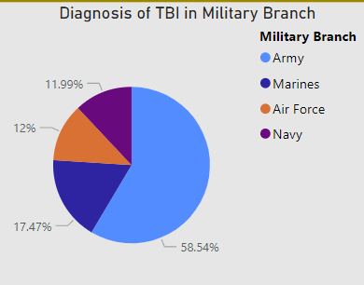
Traumatic Brain Injury in Military
Traumatic brain injury is a significant health issue that affects service members and veterans.
The Army reports the highest rates to likely sustain TBI
The rate of combat-related brain injuries in service members returning from the current conflicts in Iraq and Afghanistan is higher than in previous conflicts.
Blast injuries are a significant cause of TBIs in Military

Slide 13
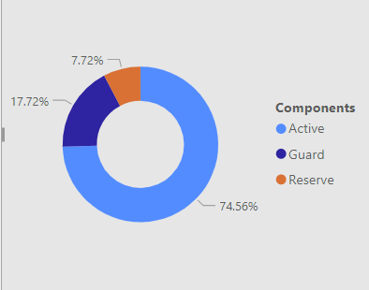
Which military Components are at risk?
Active
Due to its active combat duties and intense training exercises. Soldiers often face direct exposure to combat-related incidents, leading to a higher incidence of TBIs.
74.6%
Guard
Guard members balance civilian life with military duties, facing unique challenges.
17.7%
Reserve
This could be attributed to differences in deployment rates, specialized training, or effective preventive measures implemented within the Reserve.
7.7%

Slide 14
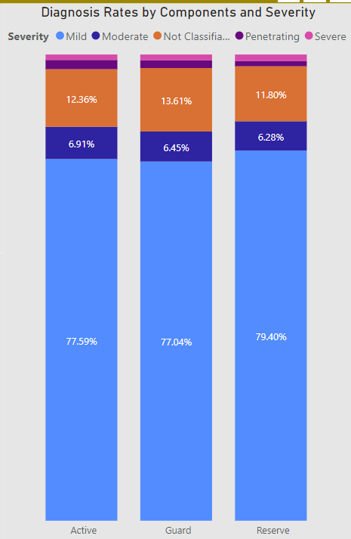
Severity Levels in Different Military Components
Army: Due to its active combat role, the Army might experience a broad range of TBI severities, including mild, moderate, and severe cases. Combat-related incidents and explosives contribute to these injuries.
Guard: Guard members, balancing civilian and military duties, might experience mild to moderate TBIs. Training exercises, domestic emergencies, and deployments can be sources of these injuries.
Reserve: The Reserve component, with a lower incidence of TBIs, might primarily experience mild TBIs due to training exercises and occasional deployments. Severe cases would be relatively rare.

Slide 15
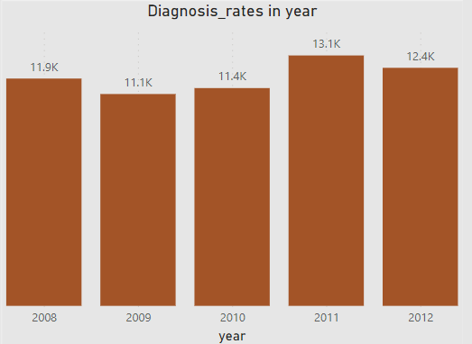
Diagnosis Rates in Different Years
Diagnosis Rates of TBI in Military increased in 2011
The year 2009 had the lowest diagnosis rates

Slide 16
Effective Care and Management of TBI
Early and Accurate Diagnosis:
Rapid Assessment: Timely diagnosis through imaging and neurological evaluations is crucial to identify the extent and severity of the injury.
Multidisciplinary Approach: Involvement of neurologists, neuropsychologists, and rehabilitation specialists ensures a comprehensive assessment.
Individualized Treatment Plans:
Tailored Interventions: Treatment plans customized to the patient's specific symptoms and needs, including physical therapy, occupational therapy, and speech therapy.
Cognitive Rehabilitation: Programs focusing on memory, attention, and problem-solving skills aid in cognitive recovery.

Slide 17
Effective Care and Management of TBI
Psychotherapy and Mental Health Support:
Counseling Services: Therapy sessions to address emotional and psychological challenges, including depression, anxiety, and PTSD often co-occurring with TBI.
Support Groups: Participation in TBI support groups fosters a sense of community and understanding among survivors.
Pharmacological Support:
Symptom Management: Medications to address symptoms like headaches, insomnia, and mood disturbances, often tailored to individual requirements.
Seizure Prevention: Anticonvulsant medications when there's a risk of post-traumatic seizures.

Slide 18
Effective Care and Management of TBI
Rehabilitation and Physical Therapy:
Physical Rehabilitation: Exercises to restore motor skills, balance, and coordination, aiding in regaining independence.
Assistive Devices: Implementation of assistive technologies and devices to support mobility and daily activities.
Family and Social Support:
Education and Training: Providing education to families about TBI, its effects, and coping strategies.
Social Reintegration: Encouraging participation in social activities and community events to combat isolation and promote reintegration.

Slide 19
Effective Care and Management of TBI
Long-Term Monitoring and Follow-Up:
Regular Assessments: Periodic evaluations to monitor progress, adjust treatment plans, and address emerging symptoms.
Lifelong Support: TBI survivors may require ongoing support services even after initial recovery, emphasizing the need for long-term healthcare planning.

Slide 20
Helmets:
Essential Gear: Stress the importance of wearing helmets in various activities prone to head injuries.
Specific Use: Highlight different helmet types for biking, sports, and motorcycling for tailored protection.
Safety Advocacy:
Bicycle & Sports: Promote consistent helmet use, emphasizing proper fit and compliance with safety rules.
Workplace & Motorcycles: Encourage strict adherence to helmet regulations in workplaces and on motorcycles, emphasizing certified, high-quality helmets.
Awareness Initiatives:
Community Outreach: Organize workshops, school programs, and social media campaigns to educate on TBI risks and prevention.
Role Modeling: Encourage influencers and leaders to wear helmets, leveraging positive peer influence within communities.
Prevention of Traumatic Brain Injury (TBI)

Slide 21
Protect your head, protect your future.
Thank You

